Slide 1
Framework Manager

Slide 2
Objective:
Brief Overview about MetaData
Examine the Framework Manager tool
Framework Manager Workflow
Review Security for Framework Manager

Slide 3


Metadata – why is it important?
Metadata is “Data about Data” – a common framework for understanding the business
A world without metadata results in
Longer development cycles
Redundant coding
Inconsistent results
Less user independence
Reduced inter-operability of existing applications
“Metadata management can provide several important benefits including increased reuse of established software assets, reduced time to perform change impact analysis, accuracy of end-user analysis, savings in training costs, speed of business intelligence tool implementations and better management decisions”

Slide 4
Examine the Role of a Cognos 8 Metadata Model
A Cognos 8 metadata model is a business presentation view of your data sources.
BI users use the model to analyze and report on their data sources.
Reporting Layer
Cognos 8 Metadata Model
Relational
Files
Cubes
Other
Notes:
Need to rephrased

Slide 5
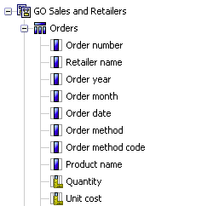
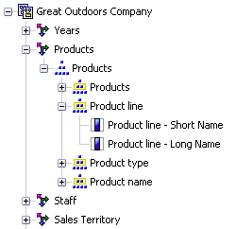
What is Framework Manager?
Cognos Framework Manager is a metadata modeling tool that drives query generation for Cognos 8.
Provides the metadata model development environment for Cognos8.
Models the business presentation of data derived from one or more data sources
Creates a model based on your business needs: Relational for reporting or Dimensionally Modeled Relational (DMR) for OLAP analysis and reporting
Relational Model Dimensional Model

Slide 6
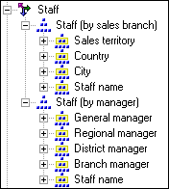
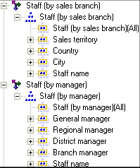
Dimensional Hierarchy
A hierarchy is an ordered list of levels or a collection of items. Each query item in a hierarchy must have a unique name.
For example, sales staff can be viewed by manager or by sales branch and can be modeled as a single dimension with two hierarchies. | If you need both hierarchies in the same report query, such as on opposing axes, you must create a regular dimension for each hierarchy. For example, here is sales staff as two dimensions.
Notes:
You can specify multiple hierarchies on regular dimensions in Framework Manager. Multiple hierarchies for a regular dimension behave as views of the same query. The first hierarchy is the primary or default hierarchy.
You can use only one hierarchy at a time in a query. For example, you cannot use one hierarchy in the rows of a crosstab report and another hierarchy from the same dimension in the columns. If you need both hierarchies in the same report, you must create two dimensions, one for each hierarchy.

Slide 7
FrameWork Manager
Hierarchy
The hierarchy of the objects in the framework manager is as shown below :
Project
Model
Namespaces
Query Subjects
Query Items
Notes:
Objects you will Use:
When you work in FrameWork Manager,you will work with a no. of Objects contained in Project.
A project contains a model,namespaces,packages,data sources & related information for maintaining & sharing model information.
A Framework Manager project appears as a folder containing project file(.cpf) & specific .xml file defining it.

Slide 8
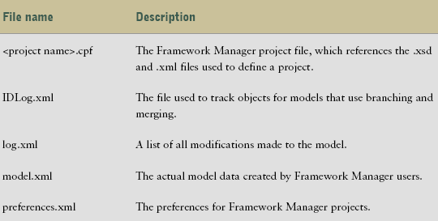
Contents of a Project Folder
The files in a project folder are unique to each project.

Slide 9
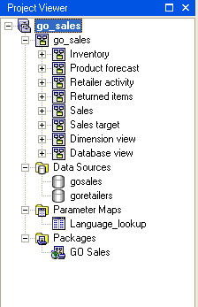
Framework Manager Project
Model : It is a set of related dimensions, query subjects & other objects required for one or more related reporting applications The Framework Manager Model is a metadata layer that adds value to the data source in several ways. Most importantly a business view of the information to simplify building reports, analyses & queries Namespaces: These uniquely identifies query items, dimensions, query subjects & other objects. You import different databases into separate namespaces to avoid duplicate names. Packages: A package is a subset of dimensions, query subjects & other objects defined in the project. It is actually published to Cognos8 server & used to create reports, analyses & ad hoc queries.
Notes:
Parameter map and data sources need to be explained.

Slide 10
Model :
It is a set of related dimensions,query subjects & other objects required for one or more related reporting applications
The Framework Manager Model is a metadata layer that adds value to the data source in several ways.Most importantly a business view of the information to simplify building reports,analyses & queries
Namespaces:
These uniquely identifies query items,dimensions,query subjects & other objects.You import different databases into separate namespaces to avoid duplicate names.
Packages:
A package is a subset of dimensions,query subjects & other objects defined in the project.It is actualy published to Cognos8 server & used to create reports,analyses & ad hoc queries.
Dimensions:
It is a broad grouping of data about a major aspect of business, such as product ,dates or markets.
The types of dimensions that you can work in Framework Manager are regular dimensions & measure dimensions.

Slide 11
Query Subjects:
It is a set of query items that have an inherent relationship
Different types of Query Subjects:
Data Source: It directly reference data in a single data source
Model : These are not created directly from data source but are based on the query items in other query subjects or dimensions including other model query subjects.
Stored Procedures: These are generated when you import a procedure from a relational data source. System stored procedures are not supported
Query Items:
It represents single characteristic such as a date when product was introduced.These are contained in query subjects or dimensions
Notes:
Query subject and query item need to be pointed into the diagram
Spell checks need to be done

Slide 12

Framework Manager Workflow
Create Project Prepare Metadata Model Metadata & Prepare the Business view | Create and Manage Packages Set Security Publish Manage the Project
Data
Sources
Import
Create
Project
Create
Project
Prepare Metadata
Model Metadata & Prepare the Business View
Create and Manage Packages
Manage
Project
Publish
Set
Security
Report Studio Query Studio Analysis Studio ….
Content Store

Slide 13
Create the Project
Analyze:
work with report authors to understand business reporting requirements
know your data and the structure of your data sources
Create:
create a project
identify the project structure
import the required metadata
Prepare Metadata
Prepare:
examine, modify, and create relationships
add multilingual support
examine and modify object properties
customize metadata for runtime to dynamically control the data returned
Display local language only
Set row-level security based on values stored in data source

Slide 14
Model Metadata & Prepare the Business View
To enhance the business view of the model, you can:
model for predictable results (model as a star schema)
model for OLAP-style queries (model dimensionally)
create one or more business views
customize metadata for runtime to dynamically control the data returned
Display local language only
Set row-level security based on values stored in data source
Create and Manage Packages
To create and manage packages, you can:
define the package contents
modify a package
specify languages
view/edit package inclusion
enable versioning

Slide 15
Set Security
Cognos 8 security is implemented through user authentication and authorized access to content.
To set security in Framework Manager, you can:
define access to packages
create security filters
define access to objects
define package administration access
Publish Packages
Publish packages to make the metadata available to users.
Packages must contain all the information that a specific user or group of users needs to create reports.

Slide 16
Manage the Project
Perform project management activities such as:
Implementing multiuser modeling
repository control
Sharing and reusing information
segmenting and linking
Action logging and synchronizing
validating a project

Slide 17
Demo Presentations:

Slide 18
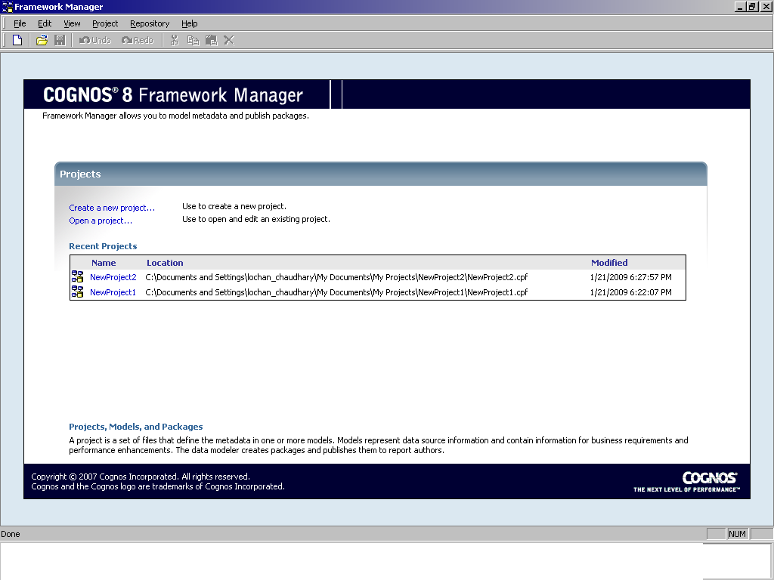
Welcome Screen :
When we open the framework manager we see the welcome screen. This gives us two options to create a new model or to open an existing model

Slide 19
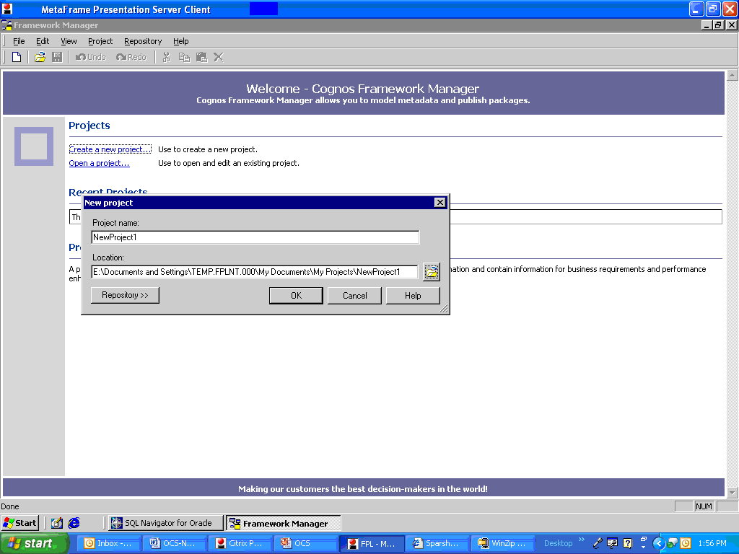
Create new model
To create a new model we first select the create a new model option which gives us an option to name the project and to select the location to which it should save the model.

Slide 20
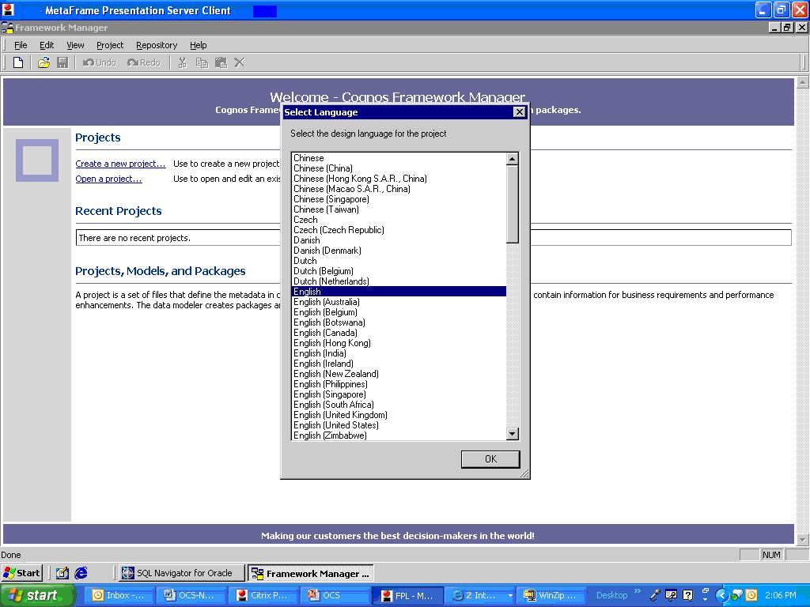
Select Language
After selecting the file location we are prompted with a select language wizard. Using which we can select a language of our choice.

Slide 21
Wizard To Import Sources
After selecting the language we are presented with a wizard to import the source.
The options are:
1. Database.
2. Cognos Reportnet Model.
3. Cognos Architect (*.xml).
4. Cognos Impromptu (*.xml).
5. Cognos Decision Stream (*.xml).
6. Third Party Metadata Sources.

Slide 22
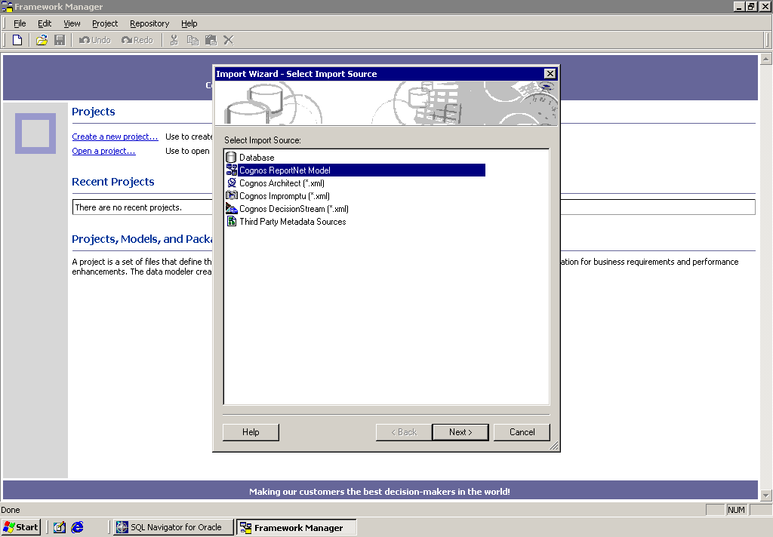
Selecting Cognos ReportNet Model
Now coming back to the options where we get to select the data source. If we want to use an already existing model to create a new model we select the Cognos Reportnet Model Option.

Slide 23
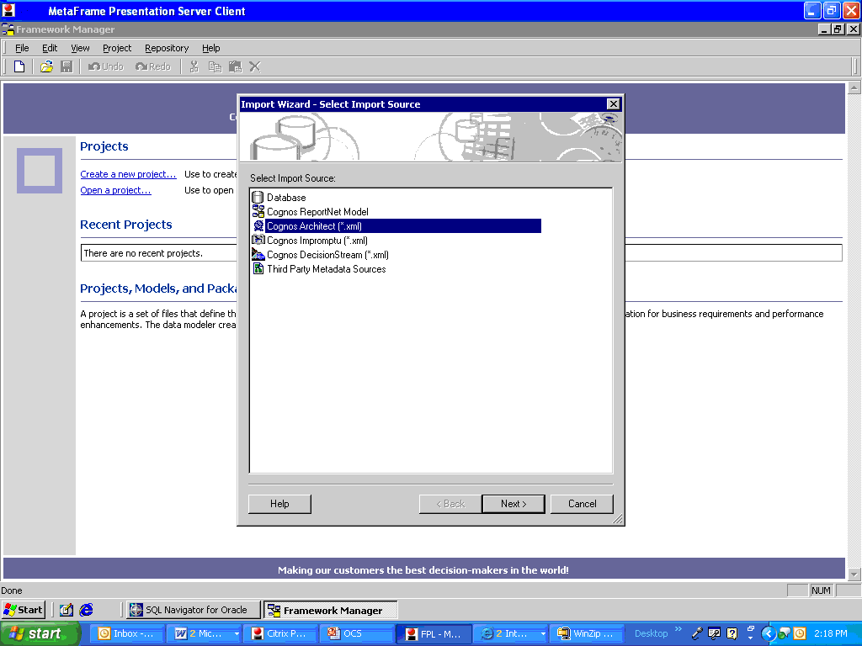
Selecting Cognos Architect
To import metadata from an Architect model or an Impromptu catalog, you must first convert them to XML files. Now select the Cognos Architect or Cognos Impromptu option and next select the XML files to create the model.

Slide 24
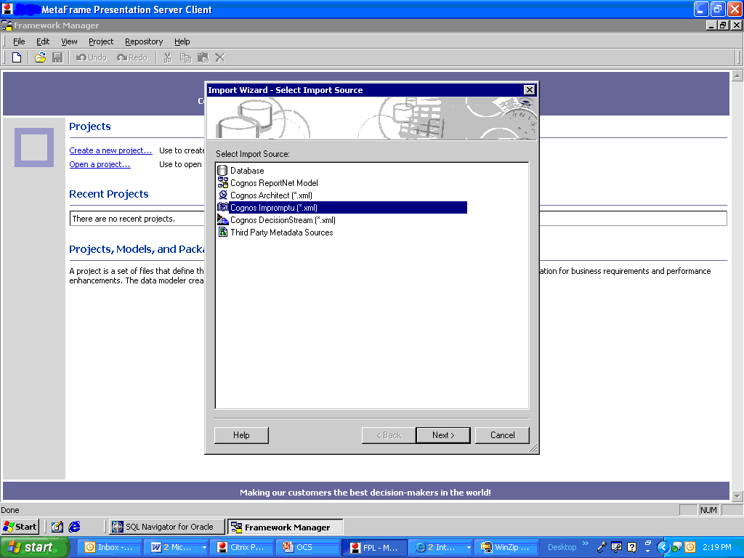
Selecting Cognos Impromptu :

Slide 25
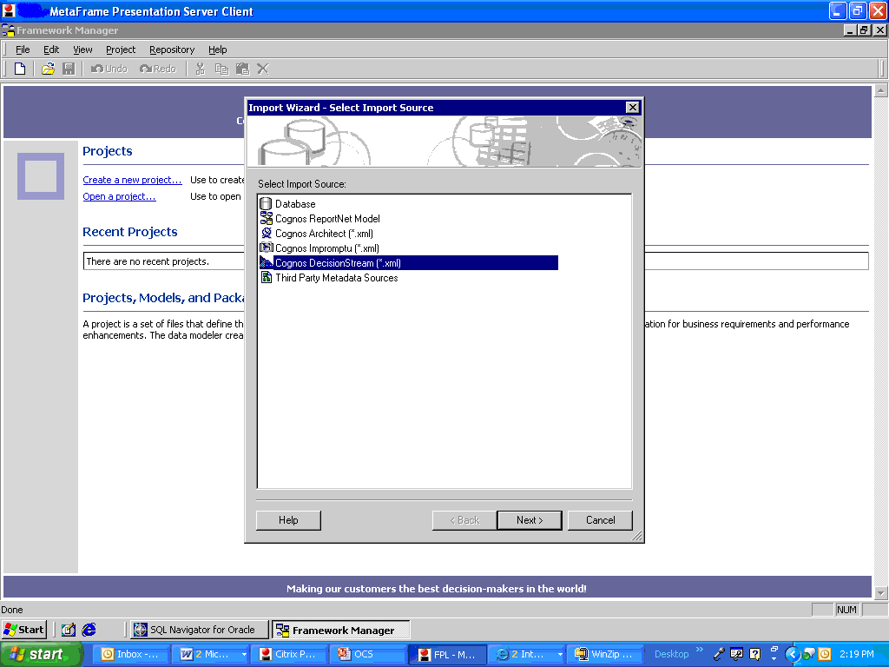
Selecting Cognos Decision stream
You can use Framework Manager to import star schema metadata from an XML file created by Decision Stream. You can import
a physical layer that contains data source query subjects that represent Decision Stream tables
a logical layer with fact and dimension query subjects organized as star schema groupings based on the physical layer
conformed and nonconformed dimensions that contain dimensional information, such as levels, keys, attributes, and hierarchies

Slide 26
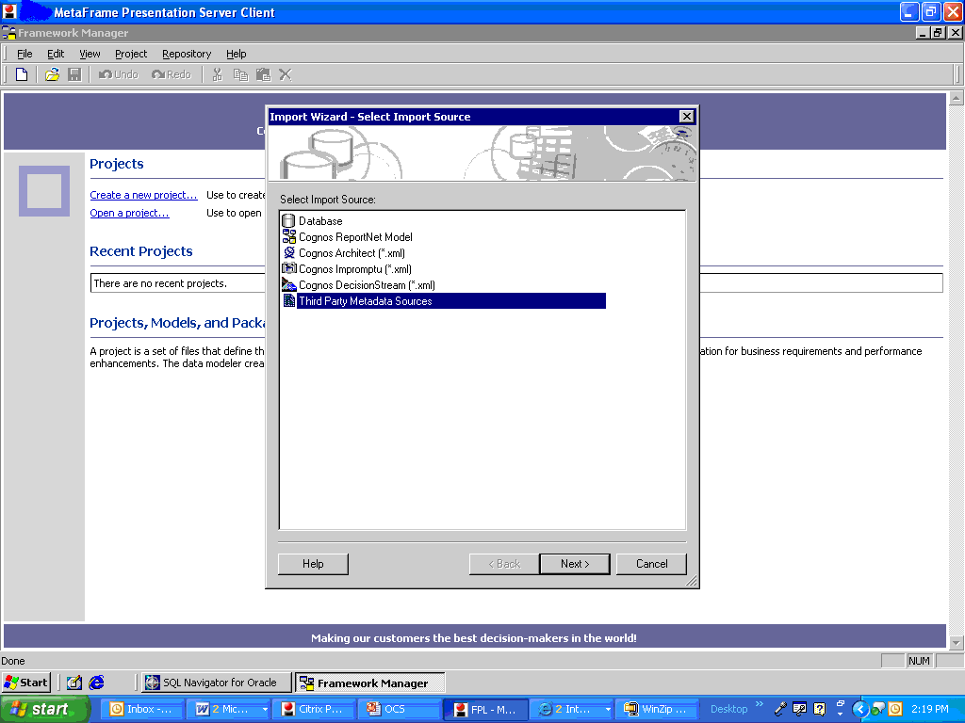
Selecting Third party Metadata Source
Metadata is imported using a metadata bridge. Import options are divided into two groups: Third-party options These are used to extract the metadata from the third-party source. Framework Manager options These are used to create the imported objects in Framework Manager
Notes:
You can import both third-party metadata and relational metadata into the same model. It is recommend that you start with a new Framework Manager model and import the third-party metadata before the relational metadata. This avoids conflicts if you import same named objects.

Slide 27
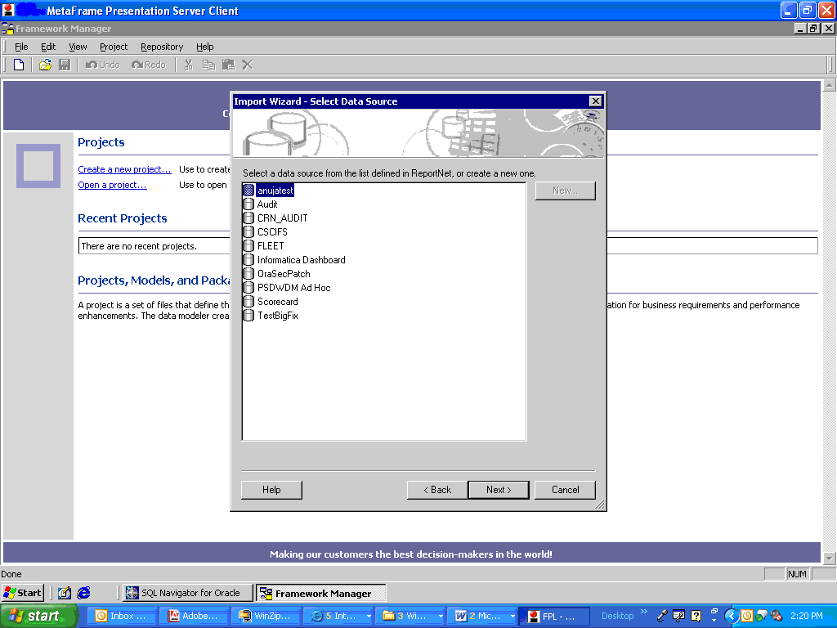
Select Database
After selecting to import the source from the database we are presented with all the data sources which are defined in the ReportNet. Here we are creating the model on the CSCIFS data source.

Slide 28
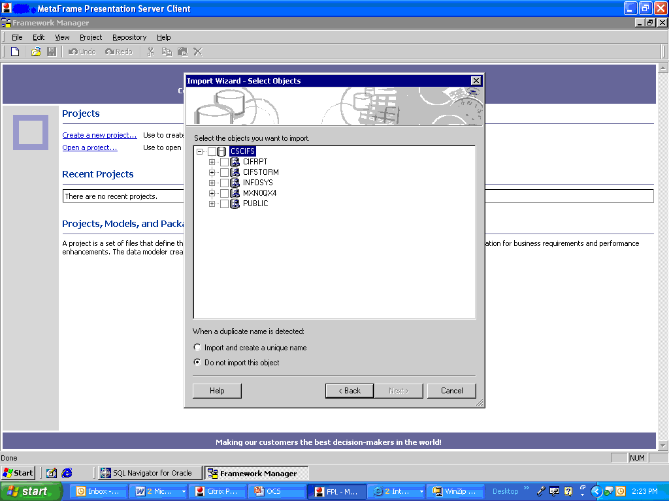
Select Schema
After selecting the “CSCIFS” data source we are presented with all the schemas in the CSCIFS data source.

Slide 29
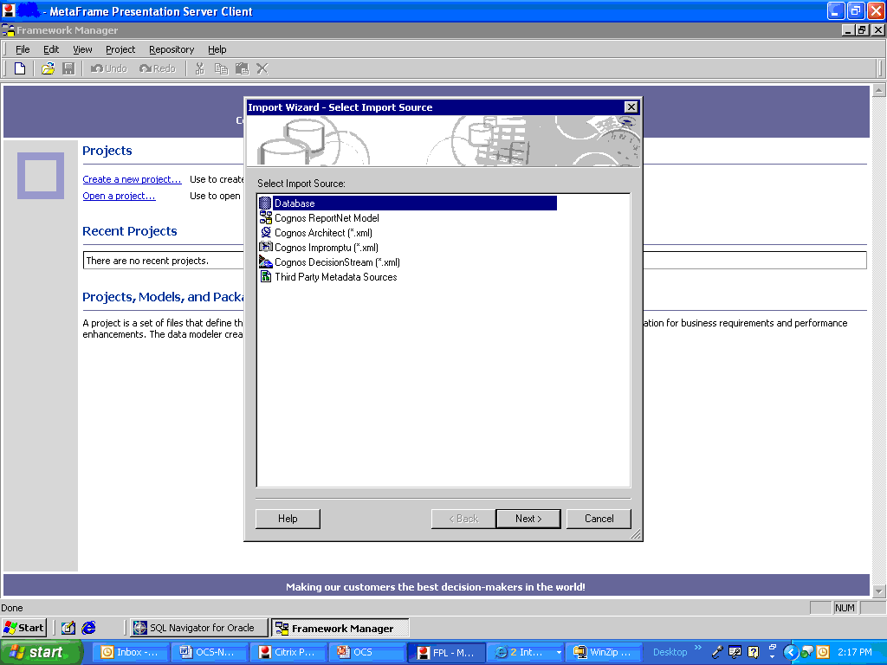
Import Source
We will be importing the source most of the times from the Database
Notes:
Why this slide

Slide 30
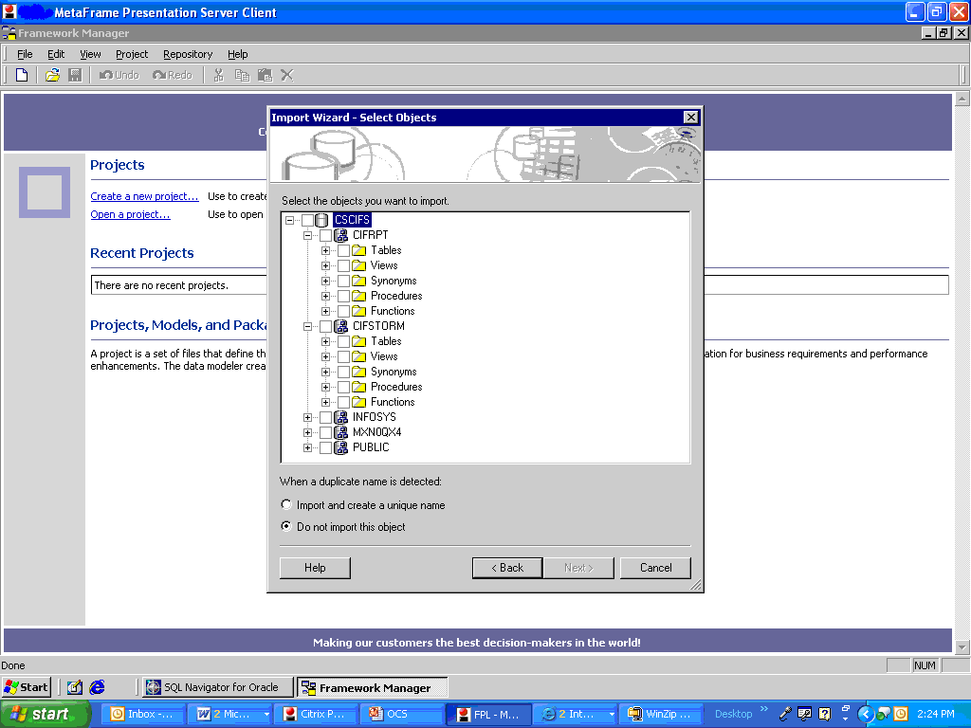
Select Objects
After selecting the schema we can further select the tables, views, procedures and functions.

Slide 31
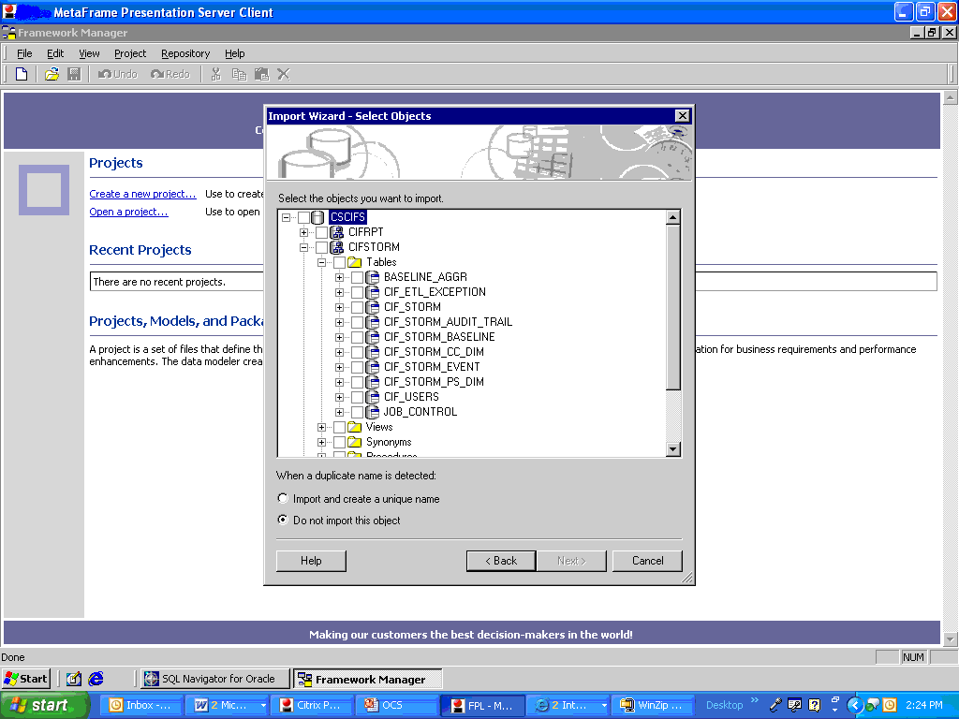
Select Tables
When we want to select a few or all the tables we go down the list and choose the different tables from the tables folder.

Slide 32
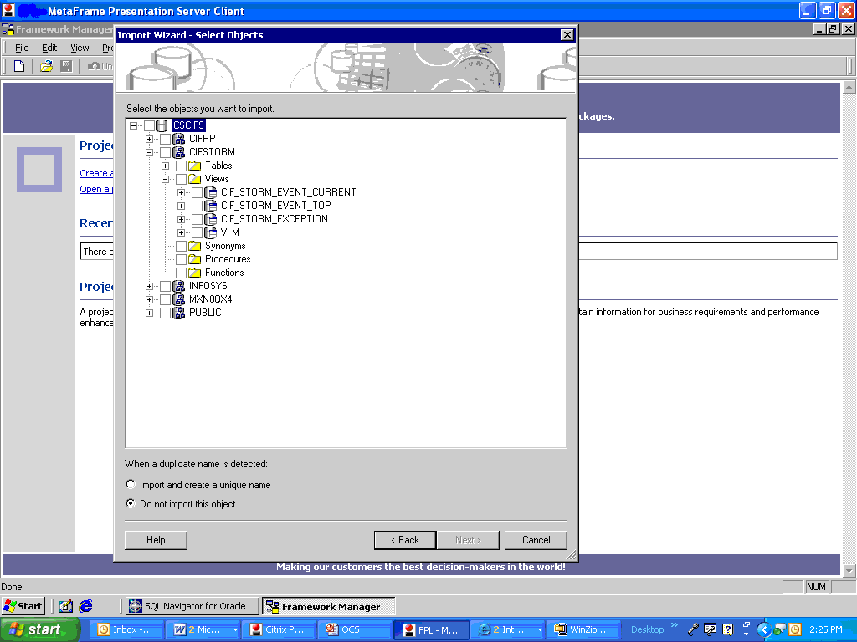
Select Views
If we have views in our database and if we require them in our model we can select them from the Views folder.

Slide 33
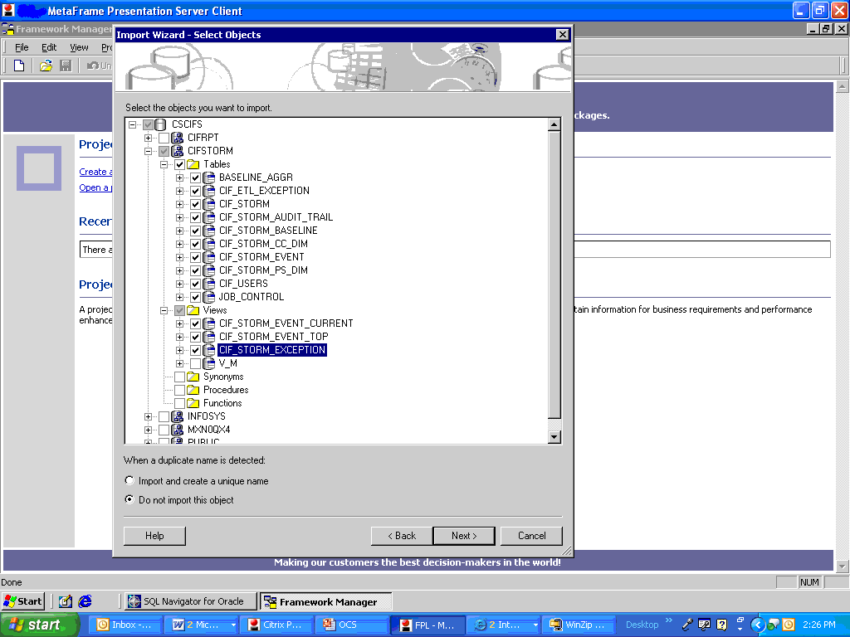
Selecting the Tables and Views
In our CSCIFS model we shall take all the tables from the database. For doing that we need to select the check boxes beside the tables

Slide 34
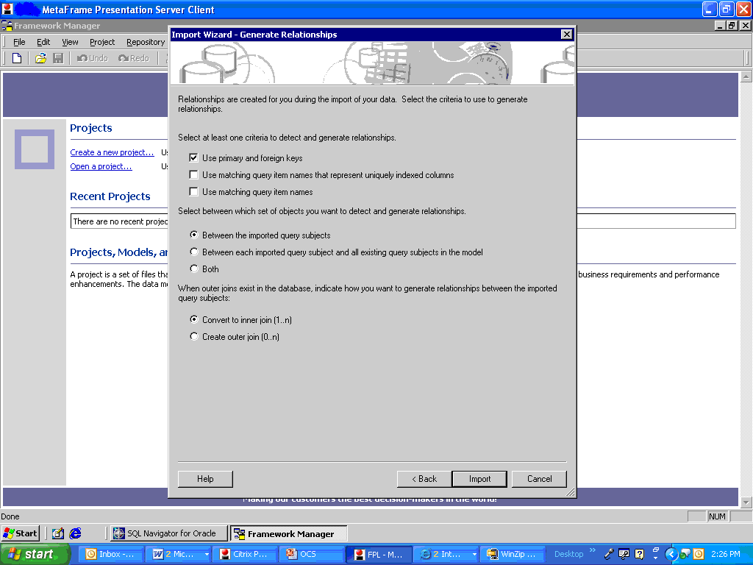
Create Relationships
After we select the tables, we are presented with a Generate relationships wizard. While importing the data from the database the framework manager gives us the option to create the relationships between the tables or to import the tables with their relationships as they are in the database.
Here we shall leave the options as they are which would bring the tables from the database with their default relationships.

Slide 35
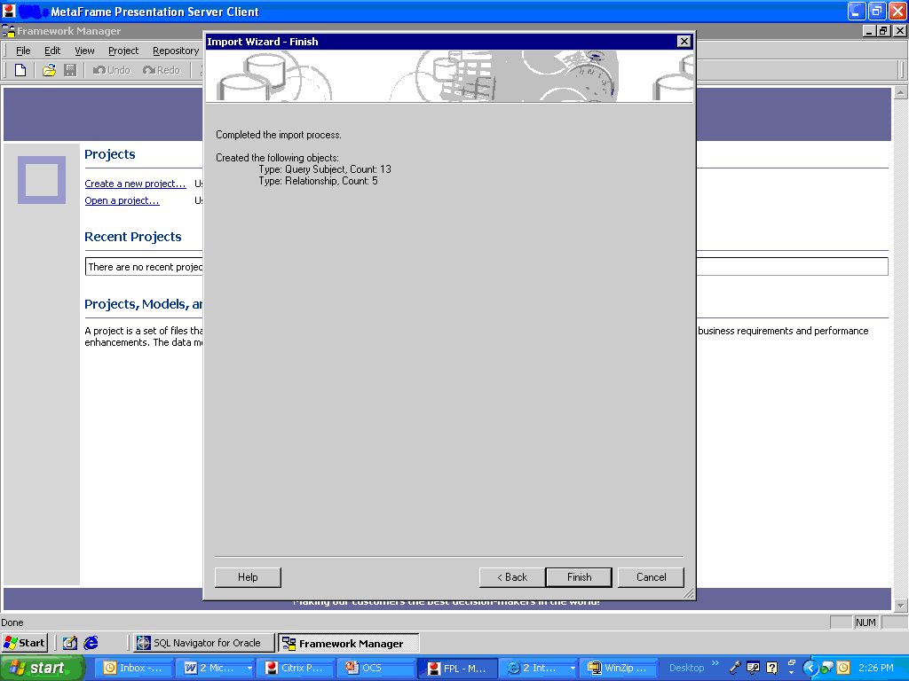
Object Count
After we select the relationships the wizard presents us with the count of tables and relationships imported

Slide 36
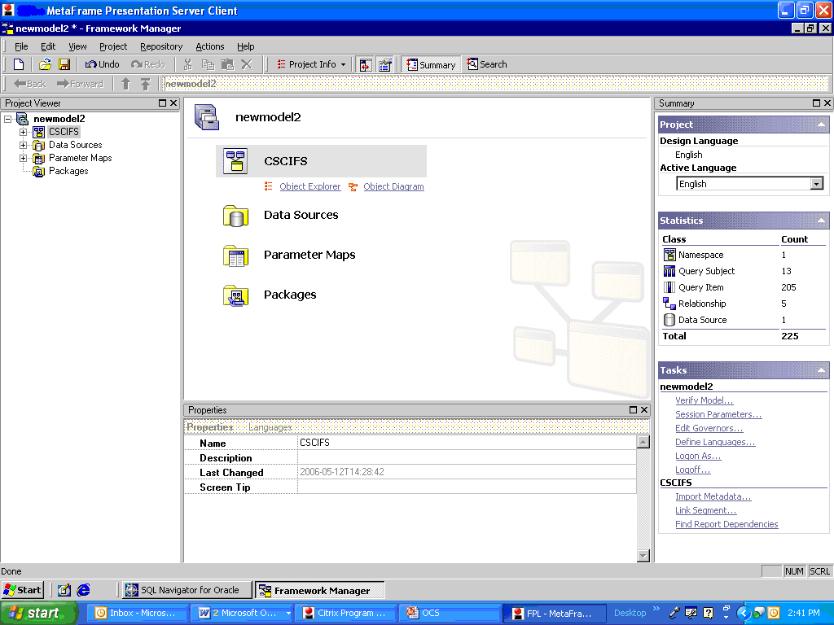
The Framework manager screen:
Notes:
Put call outs for project viewer pane , summary pane, properties pane and object explorer pane.

Slide 37
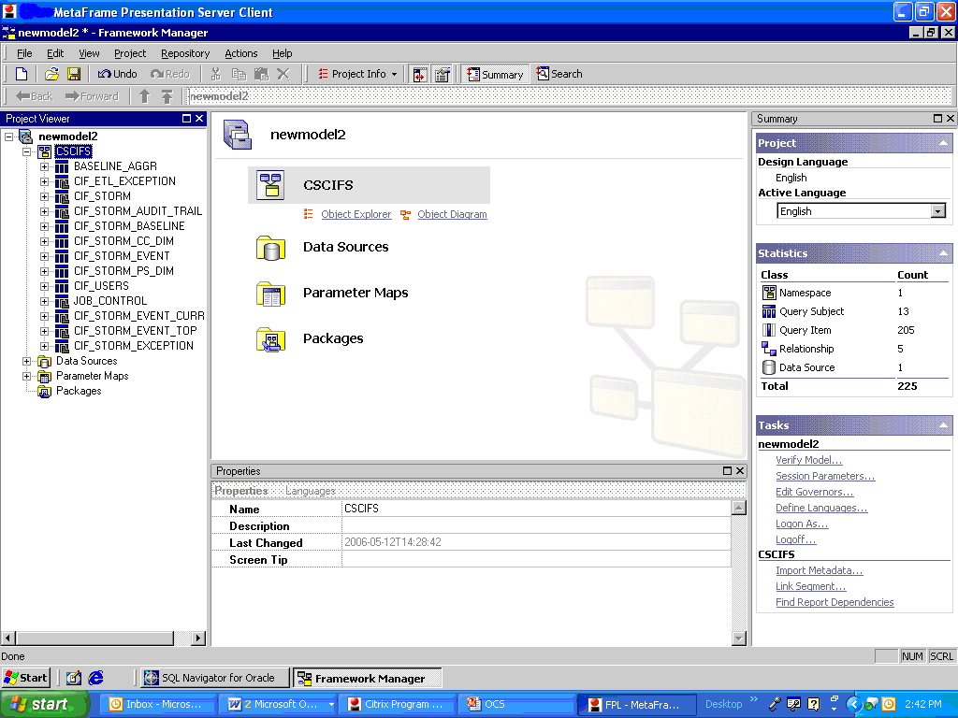
Project Hierarchy
We can see the hierarchy the project name being newmodel2 then comes the namespace CSCIFS then all the query subjects and query items.
Notes:
Driver={SQL Native Client};Server=bhukrk50530d;Database=AdventureWorks; Uid=silabbbsr;Pwd=silabbbsr@1;

Slide 38
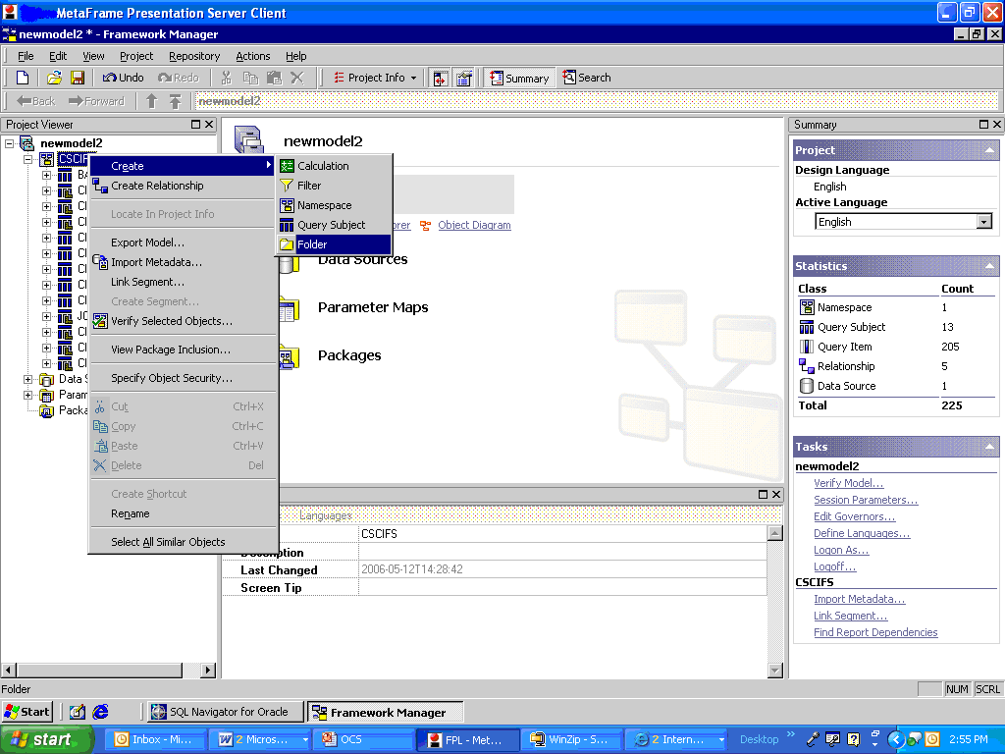
Create Folder
To create the folders right click on the namespace and select the create option you will see the sub options to create a Calculation, Filter, Namespace, Query subject and a Folder. We select to create the folder option.

Slide 39
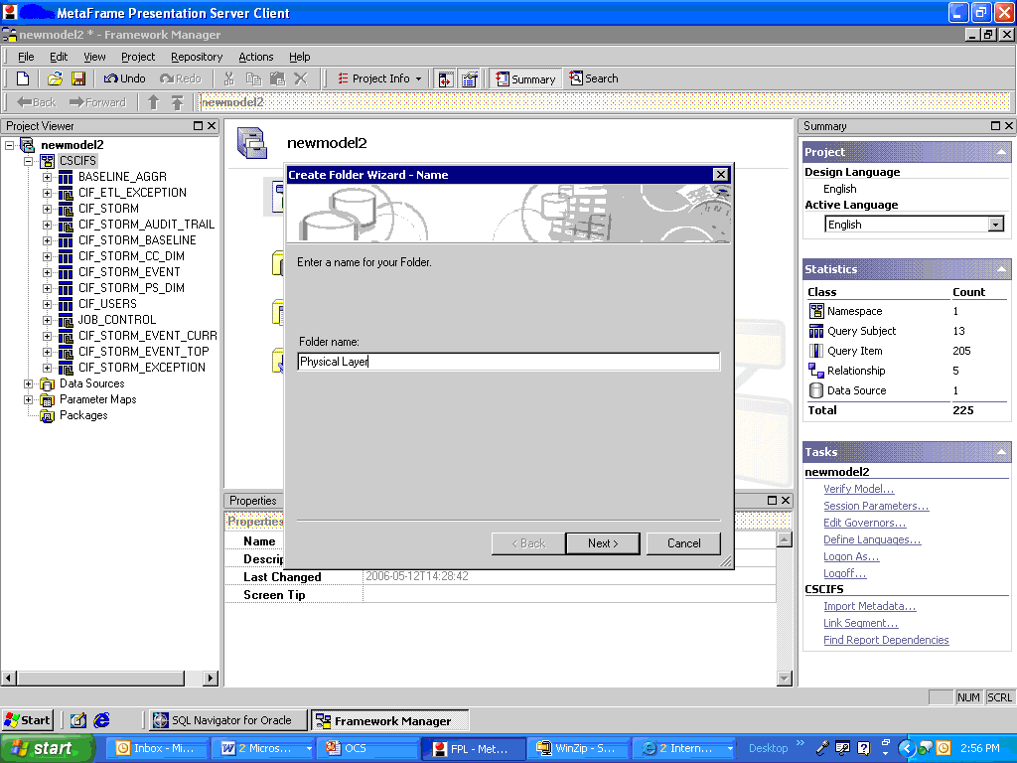
Create Physical Layer Folder
When you select the create folder option we get an option to name the folder. Name it as Physical Layer

Slide 40
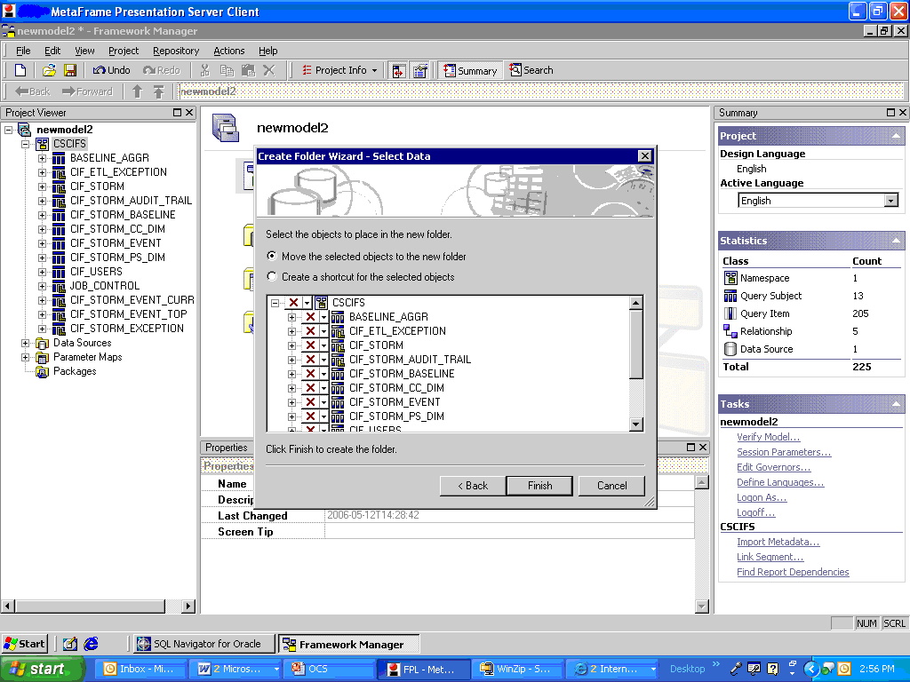
Select Query Items

Slide 41
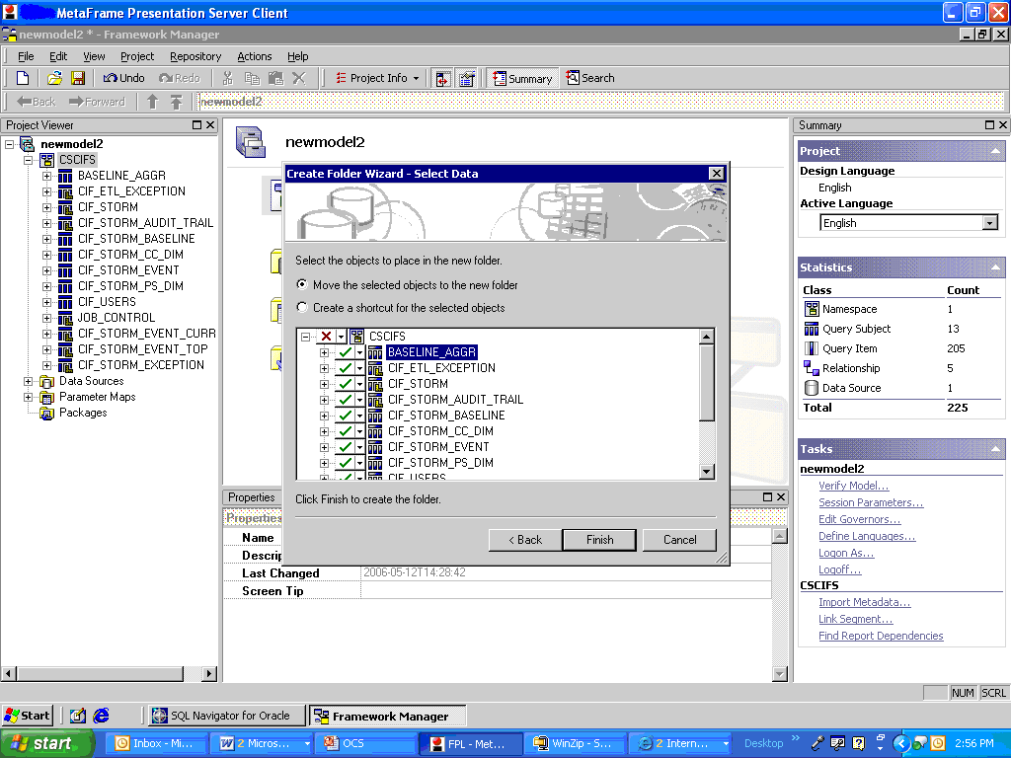
Select Query Subjects
We select all the query subjects for our model.

Slide 42
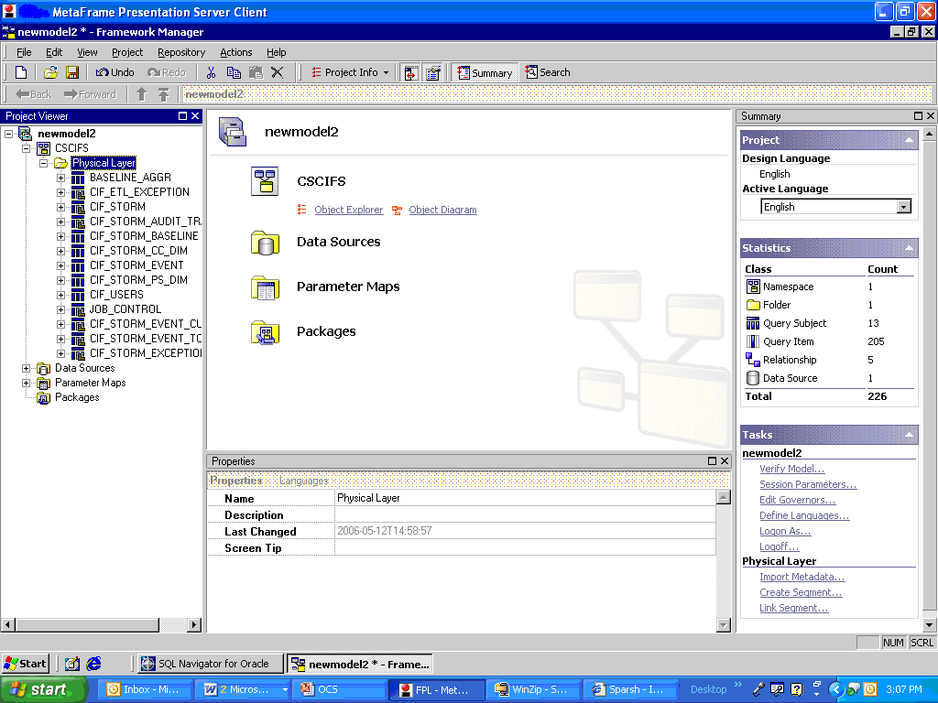
Create Business Layer Folder
After creating the Physical Layer folder and moving the query subjects in it we now move on to create the Business Layer folder.

Slide 43
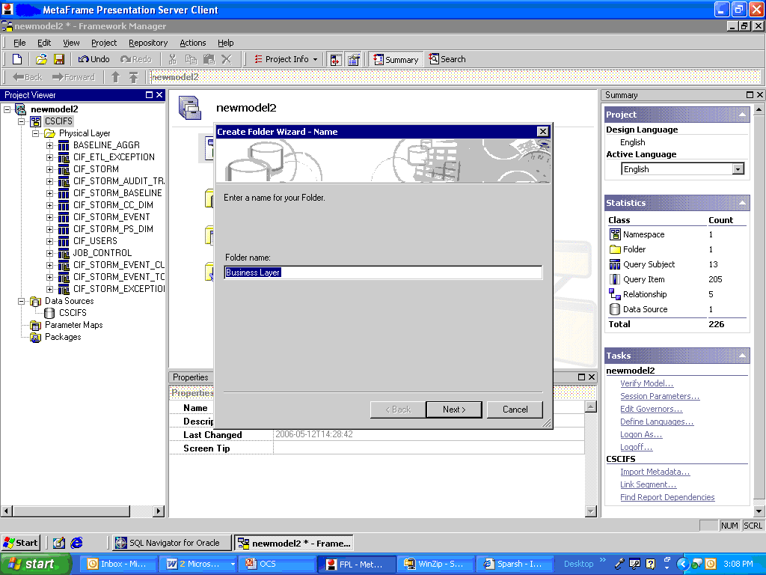
Name the folder

Slide 44
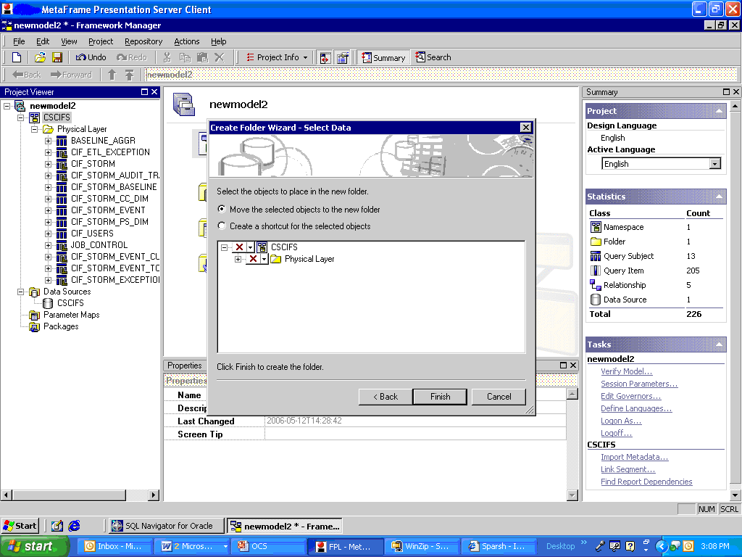
Select Query Items
Again we right click on the namespace and select to create a folder and name it as Business Layer. We are again prompted with a select data prompt from which we can select the data items.We uncheck them and create the Business folder with no data items to start with.

Slide 45
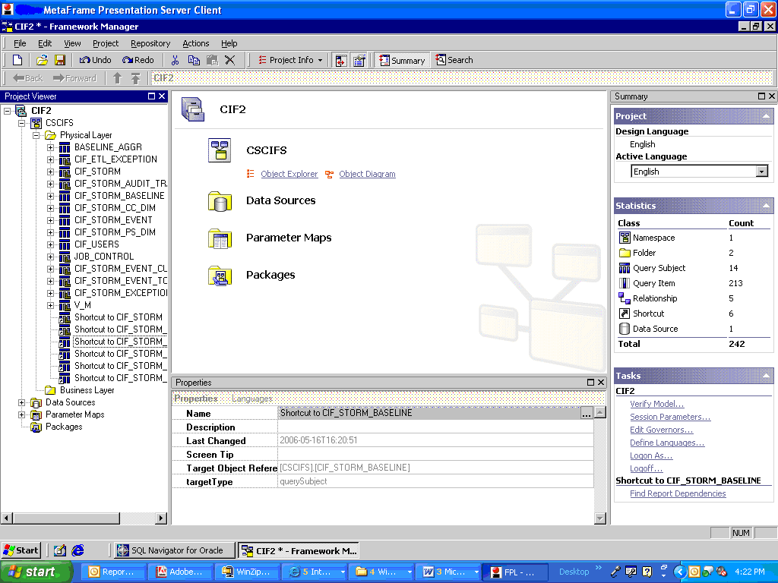
Create Shortcut
We move the shortcuts of the query subjects on which the model has to be made to the Business Layer. The advantage of using the shortcuts is that if we change any query subject in the physical layer and if we use the short cut of the query subject in the business layer the change gets reflected in it. If we don’t use the shortcuts then we would need to make the change wherever the query subject is present.

Slide 46
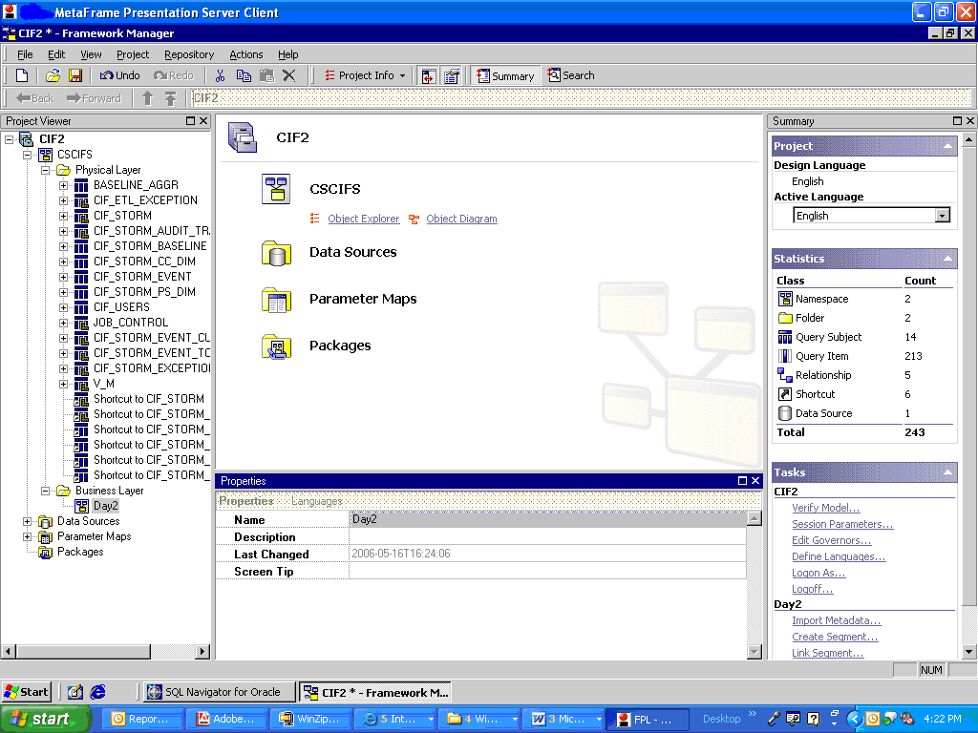
Create Namespace
In the Business Layer create a namespace with an appropriate name in this case Day2 and move all the shortcuts to this namespace from the physical layer by doing a drag and drop.

Slide 47
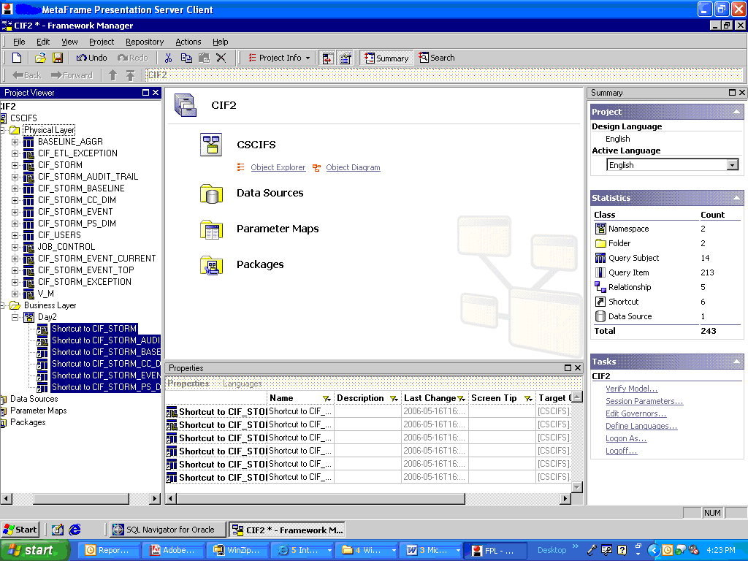
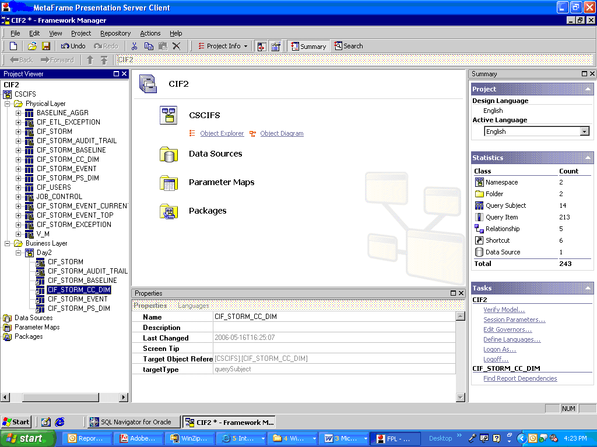
Change Shortcut Names
Change the names of the shortcut items so that it does not include the prefix “shortcut to”

Slide 48
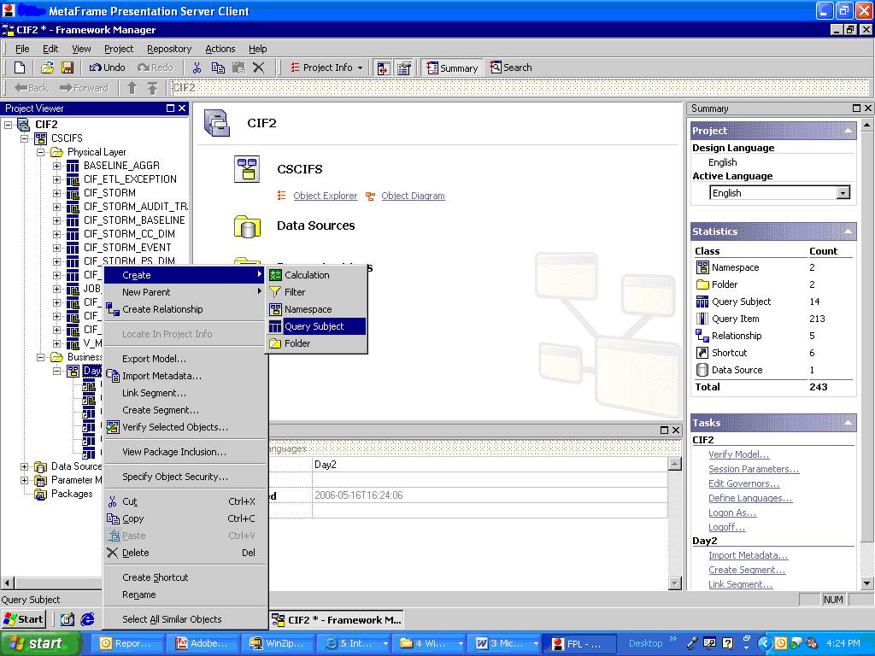
Create Query Subject
Now we go ahead to create a model level query subject which wont be there in the database. Right click on the namespace in the Business Layer in this case “Day2” and select to create a query subject.

Slide 49
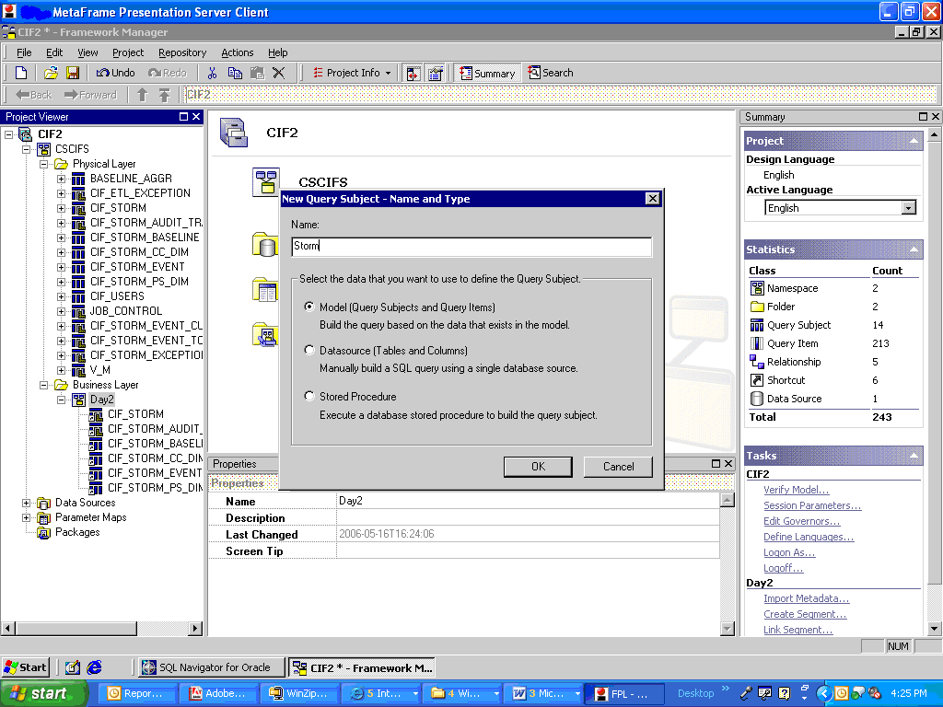
Name the Query Subject
Name the query subject in this case “Storm”.

Slide 50
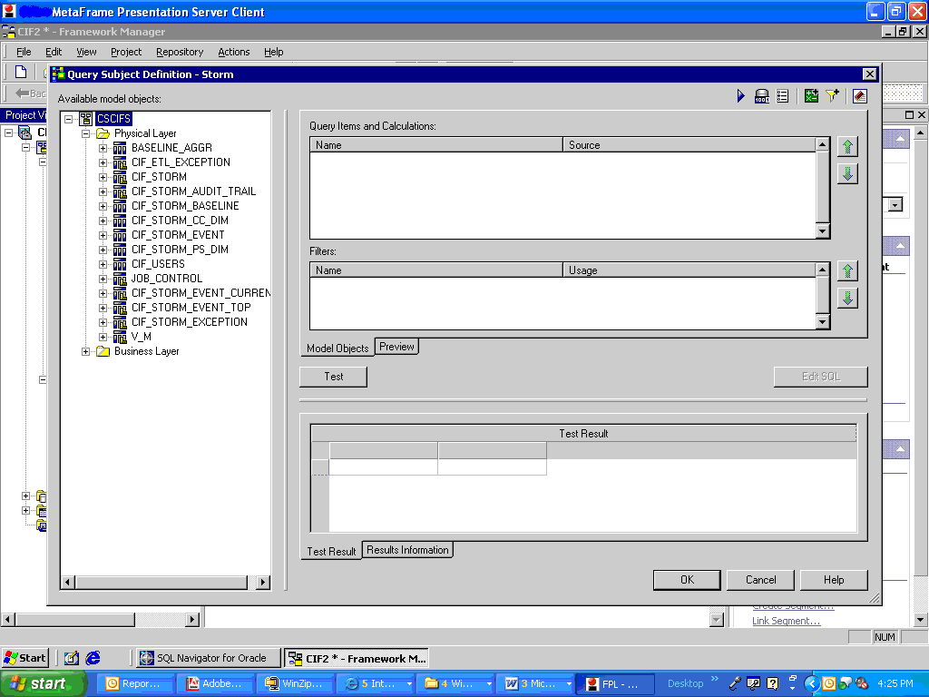
Select the Query Items
After naming the query subject we get a prompt as shown below. On the left hand we can see the physical layer folder and all its items as well as the Business layer folder with all its items.

Slide 51
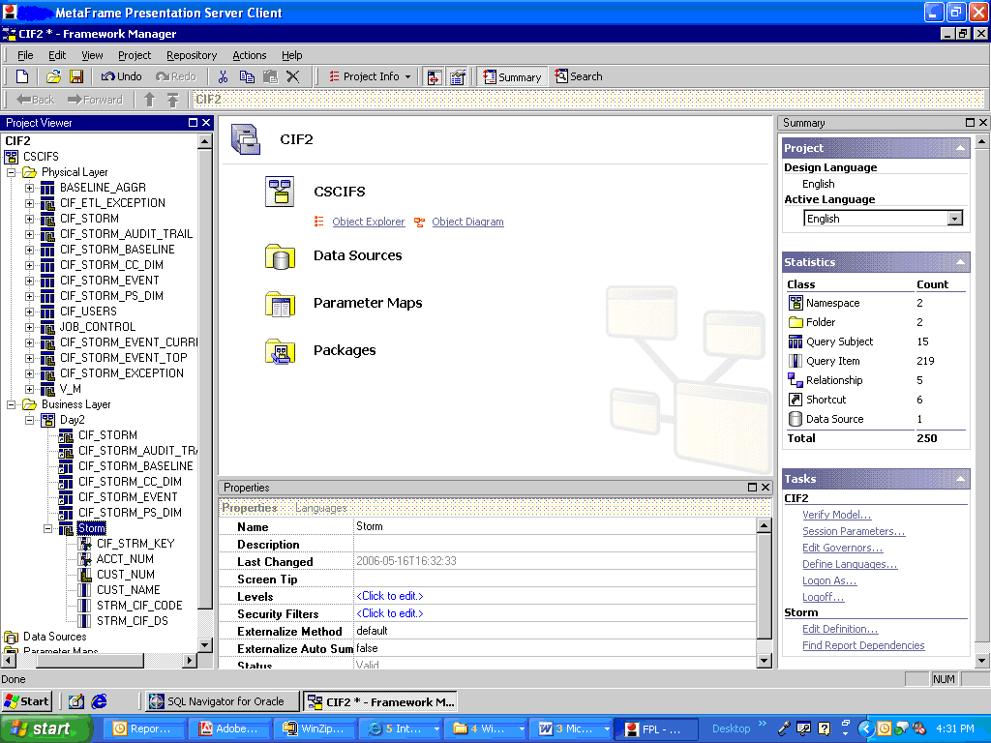
Project Viewer
We can see in the screen below the created query subject.

Slide 52
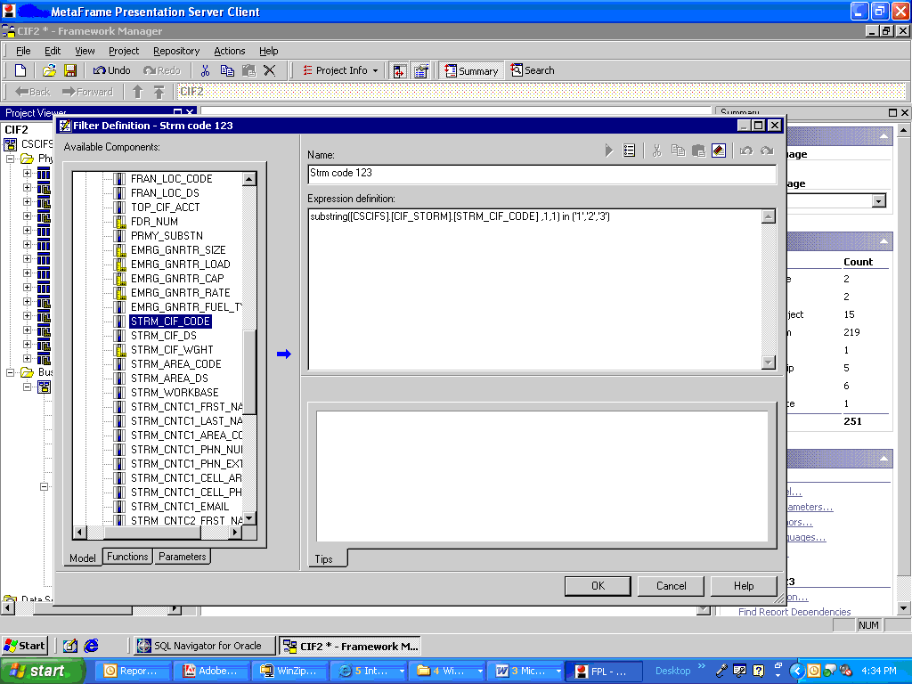
Create Filter
To create the filter right click on the namespace in the business layer and select to create the filter. We are prompted by the screen to include the filter conditions. We can specify the filter condition which we want in this model I have used a filter which filters the records based on the STRM_CIF_CODE whose first character is either ‘1’,’2’ or ‘3’.

Slide 53
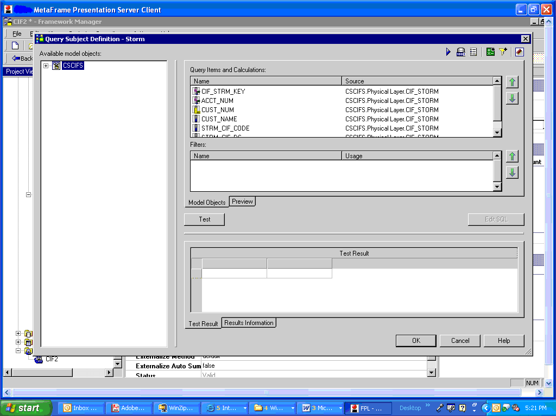
Create Calculation
To create the calculation open the query subject which we created by double clicking on the query subject and on the right hand top we find the icon for calculation on clicking it we are prompted with the screen where we describe the calculation .In this example we make a calculation of concatenating a STRM_CIF_CODE item with STRM_CIF_DS.

Slide 54
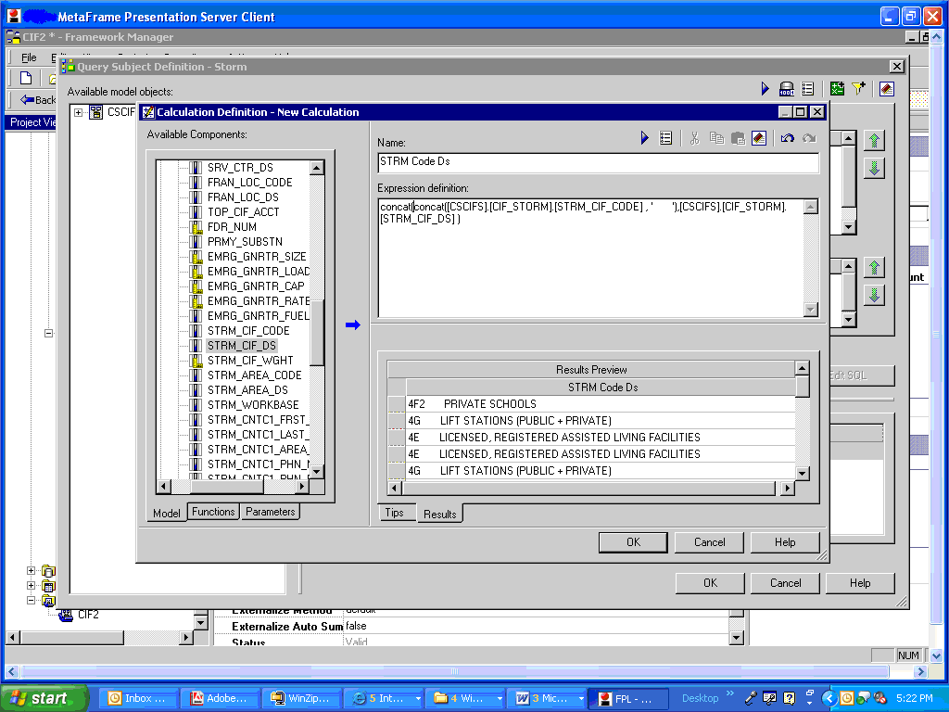
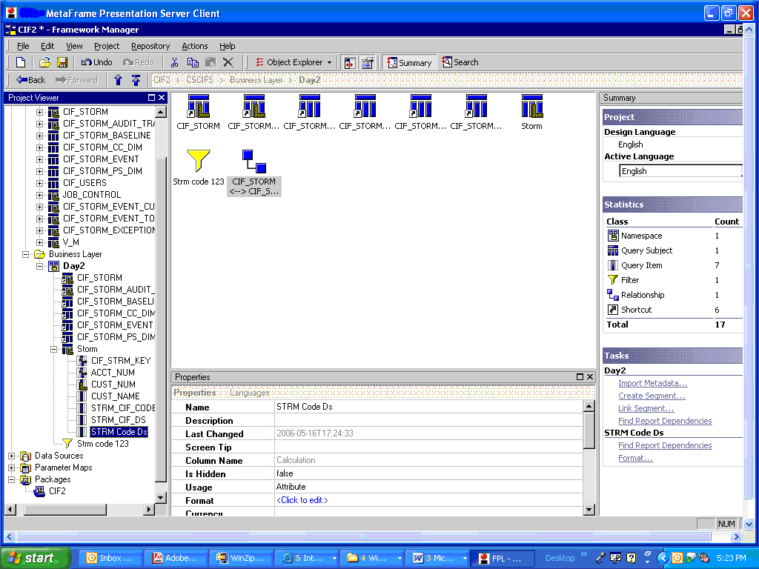
Define Calculation
On the prompted screen we write the calculation to concatenate the two query items STRM_CIF_CODE and STRM_CIF_DS.
Once we create the calculation it appears as a column in the query subject and we can use the same in the reports directly

Slide 55
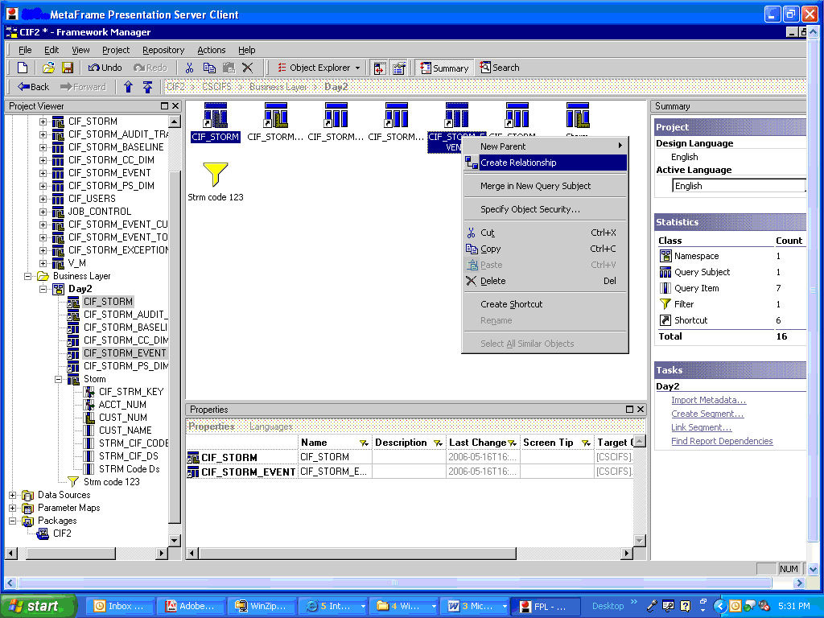
Create Query Relationship
Go to the Object Explorer window, we would see all the query subjects and the filters on the window. Select two query subjects between whom we need to create the relationship. In this case we select CIF_STORM and CIF_STORM_EVENT right click on one of the query subjects and select the Create Relationship option.

Slide 56
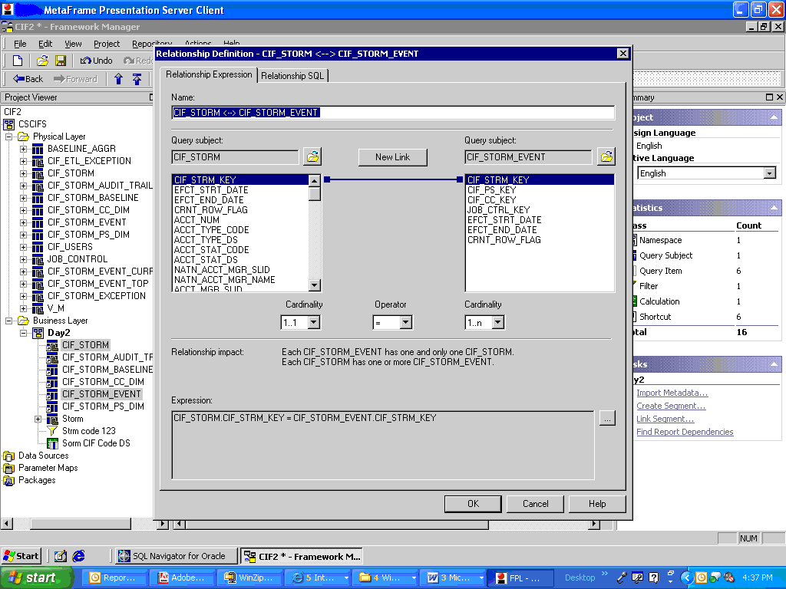
Define the cardinality
After we select the create relationship option we get a window where we can select the columns on which the relationship is defined and the cardinality. By default it makes a 1..n relationship

Slide 57
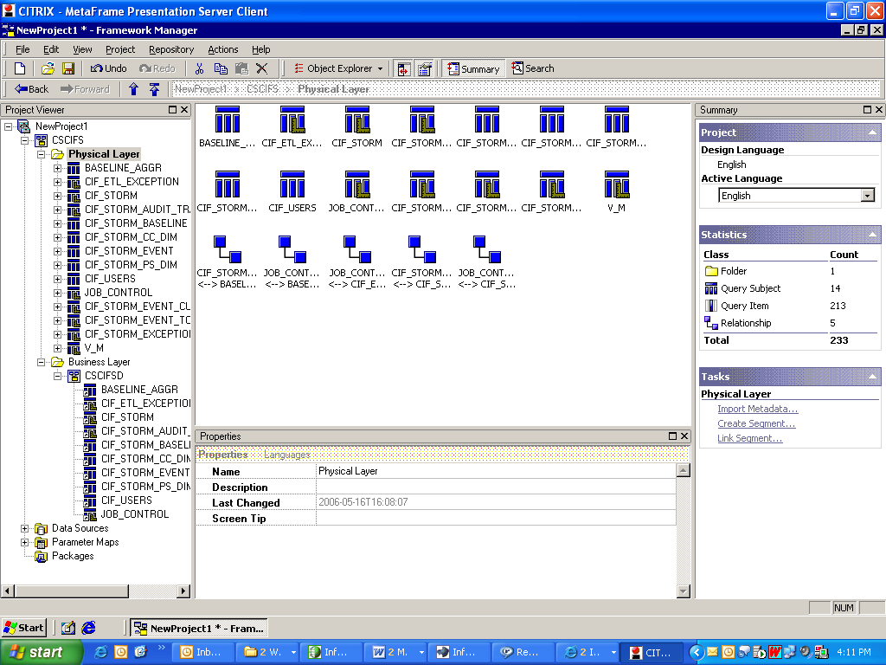
Viewing the relationship
If we want to view the relationships between the tables in the physical layer select the object explorer and select the physical layer folder. We can see below the query subjects and the default relationships. If we want the relationships in our business layer we create a shortcut of the relationship in the business layer.

Slide 58
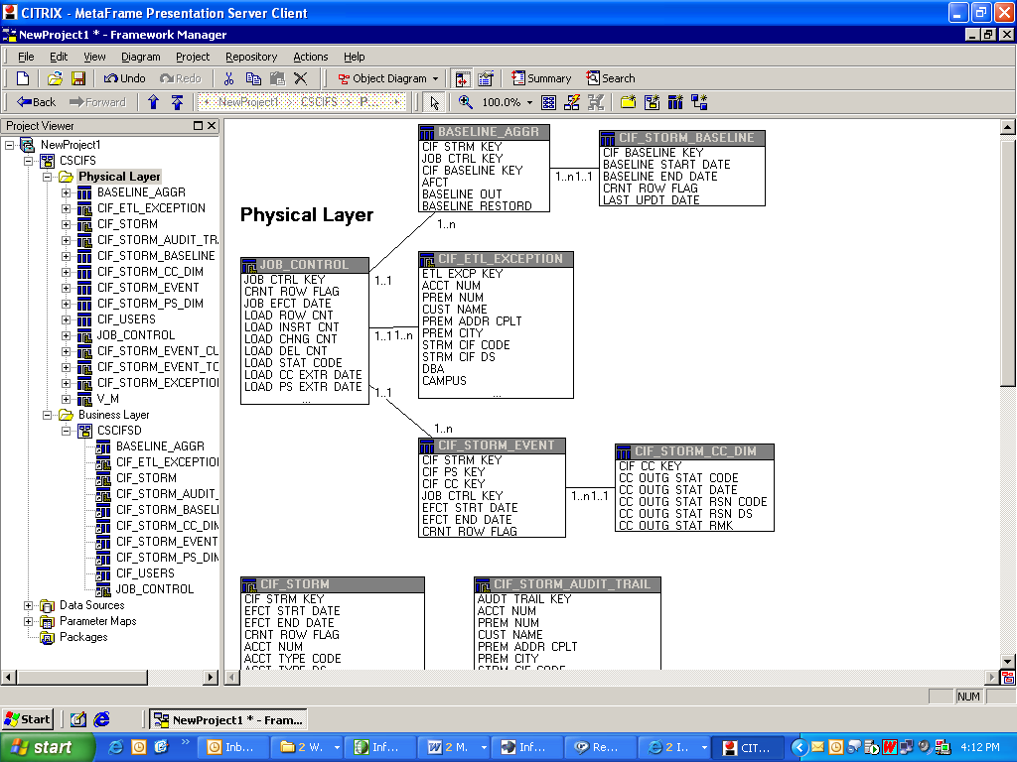
Object Diagram
We can see the relationship in a pictorial format by selecting the object diagram option.

Slide 59
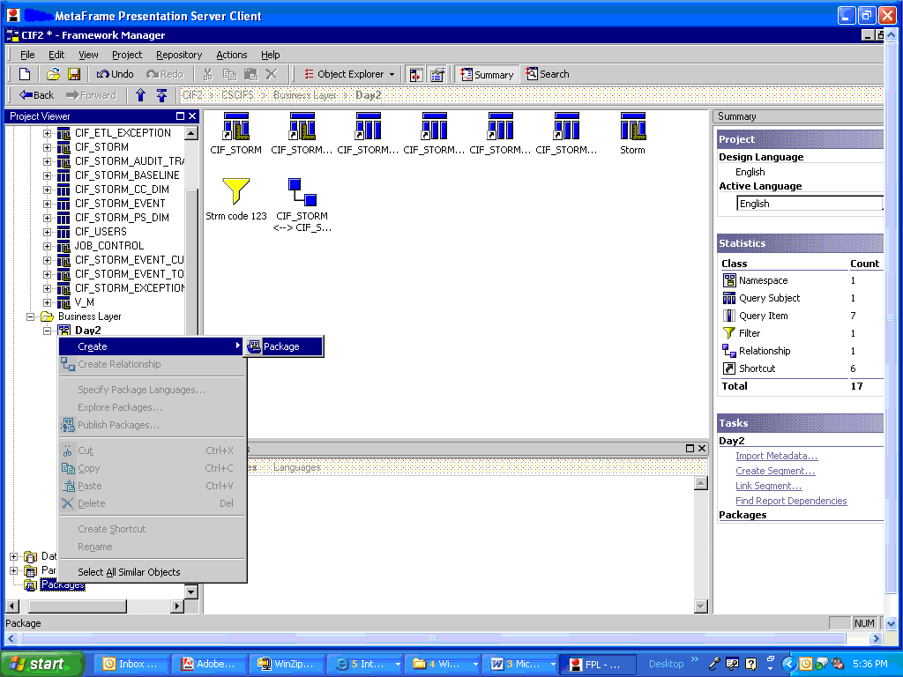
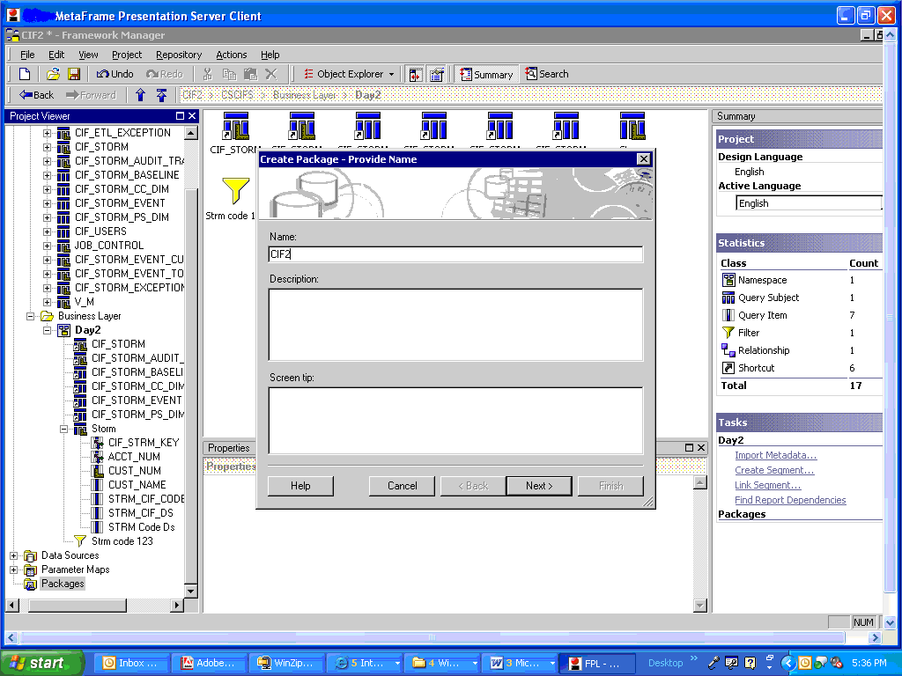
Publish & Naming the Package
Publishing the package is nothing but to make the model available to the reportnet user. We publish the model on the cognos reportnet server. Right click on the Package and select to create a package option.

Slide 60

Choose the Objects

Slide 61
Security
IBM Cognos framework services offer a common security facility. This enables single-signon, secure access to all business intelligence, planning, and scorecarding content. It provides an easy way to manage security for both internal and external users, giving IT central control over all intranet and collaborative extranet applications. Cognos software addresses two critical aspects of information security:
Authentication (logon) security: Based on logon credentials or operating-system account, Cognos software which user class or classes a user belongs to.
Authorization security: In conjunction with other business intelligence components and based on the user's class, Cognos software security facility determines what information is accessible to the user.
The open security from Cognos software supports all of the popular authentication sources including LDAP (Netscape, Sun One (formerly Iplanet)), Active Directory, NTLM (NT Domain), Netegrity, and the existing Cognos security facility. It also features a complete SDK for custom security sources

Slide 62

Add Security
The wizard next prompts us with an add security window where we can define the different security levels to the users.

Slide 63

Select Function Sets
The wizard next prompts us with an option to include the various functions sets which belong to different databases .By default all the function sets are chosen.

Slide 64


Selecting Location & Publishing the Package
The wizard next prompts us a window where we select the location of the cognos server on which the package should be published.
After clicking the publish button the package “CIF2” appears in the package folder and will also be visible to the reportnet users on the cognos.

Slide 65
Thank You
Thank You

